Slide 1
Modernization of Administrative Website
(DigiClips)
sddec24-03
Derek Brandt, Tyler Orman, Israel Sanchez, Aryan Rao, Danh Hoang
Client: DigiClips
Faculty Advisor: Dr. Ashfaq Khokhar
Website: https://sddec24-03.sd.ece.iastate.edu

Slide 2
Today’s Agenda
Who is DigiClips
Design
Next Steps
Project Scope
Results

Slide 3
Who is DigiClips?

Slide 4
The Digiclip Mission
What They Do: Provide comprehensive media monitoring services
TV, radio, podcasts, webstreams
Target Market: PR firms, lawyers, politicians, journalists
Business Model: Sell software rights to allow users to access media monitoring tools
Notes:
Target Market: Anyone that needs constant news monitoring of themselves or their clients. The owners' intent is to sell the entire website once it has reached an optimal state.

Slide 5
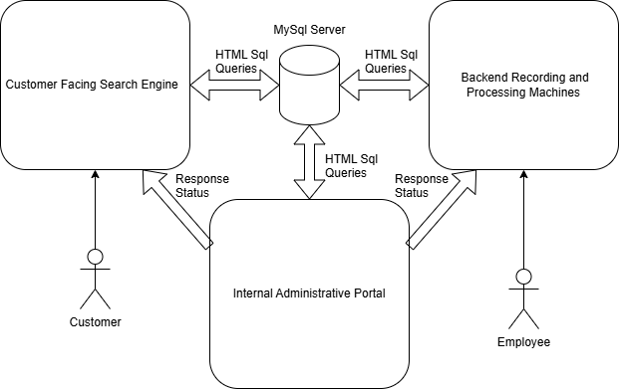
DigiClips Overall Design
Made up of four large subsystems…
Search Engine
Recording/Processing Machines
Administrative Website
MySQL Server
Each system has been previously worked on.
Our team will only effect…
Administrative Website
MySql Server

Slide 6
Project Scope

Slide 7
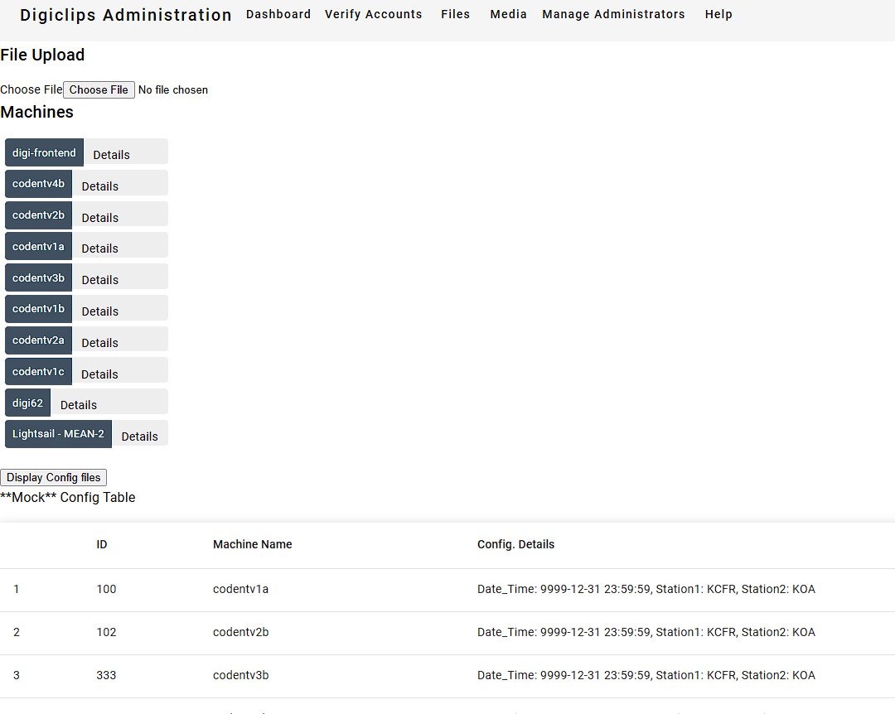
Problem Statement - Main Challenge
Outdated System - Current admin portal is inefficient and overly complex.
Operation Challenges
Increased Maintenance Costs
Reduced Product Value
Notes:
Operation Challenges - Accessing critical data is difficult. Increased Maintenance Costs - Complexity of the system slows developer’s productivity; leading to higher maintenance costs.
Reduced Product Value - Low UX reduces potential revenue.

Slide 8
Problem Statement - Goal
Modernize Administration Website - 4 strategies identified
Library and Framework Updates
System Optimization
User Experience Enhancements
Future-Proofing
Notes:
Library and Framework Updates - Update libraries and versioning practices. System Optimization - Reduce complexity by removing redundant code. User Experience Enhancements - Redesigning the interface to a modern, streamlined dashboard for users.
Future-Proofing - Establish development guidelines to simplify maintenance and scalability.

Slide 9
Users and Stakeholders
Groups Identified
Software Engineer
Code is maintainable: decreases development time
Media Recording Engineer
Error logs and metrics

Slide 10
Users and Stakeholders
Groups Identified
Managers/Owners
Access to everything
Super-admins
Customer Service
Update to customer accounts
Identify Server Status

Slide 11
Requirements

Slide 12
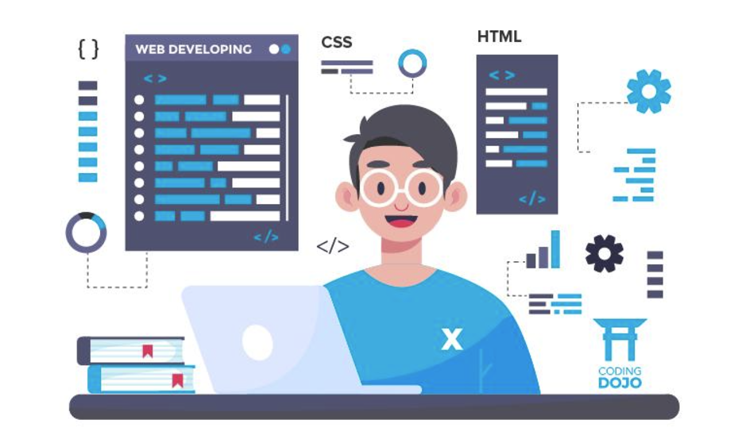
Key Development Requirements
HTTP Rest requests be in Angular Service
Clean & working Master Branch
Develop features in box format
Test modules or plan test

Slide 13
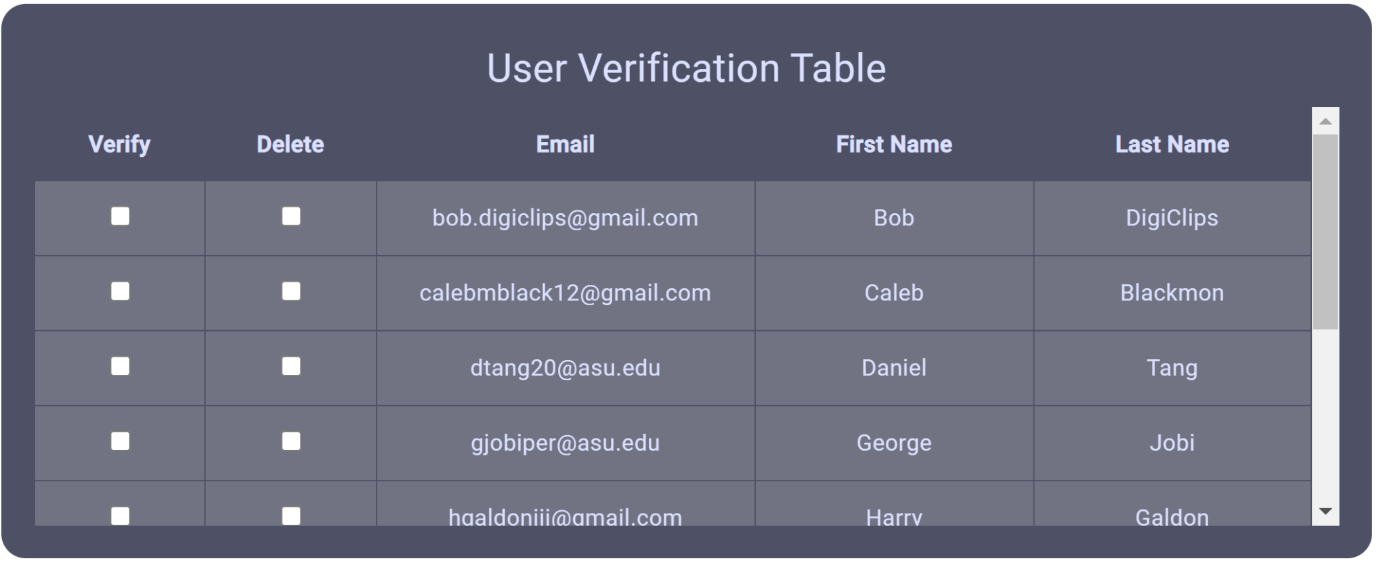
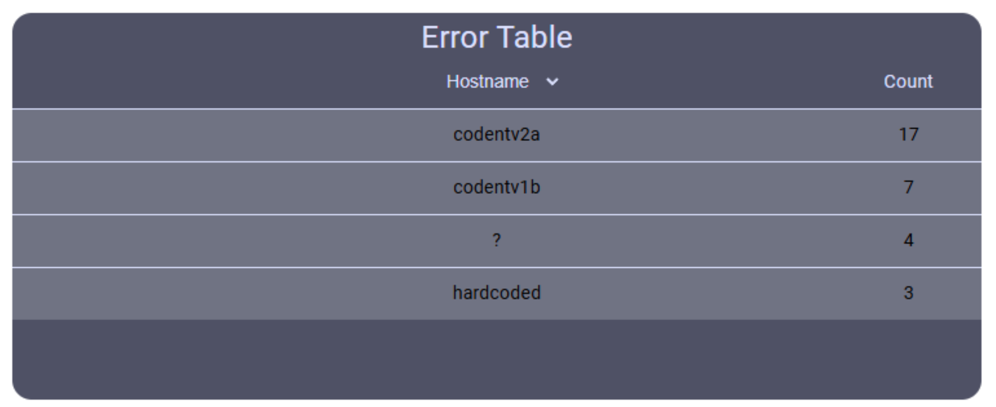
Key Functional Requirements
Display statistics/data from backend machines
Errors & Uptime
Handle ~2000 error messages at once
User login and editing
Search Engine
Super-admins can manage other accounts

Slide 14
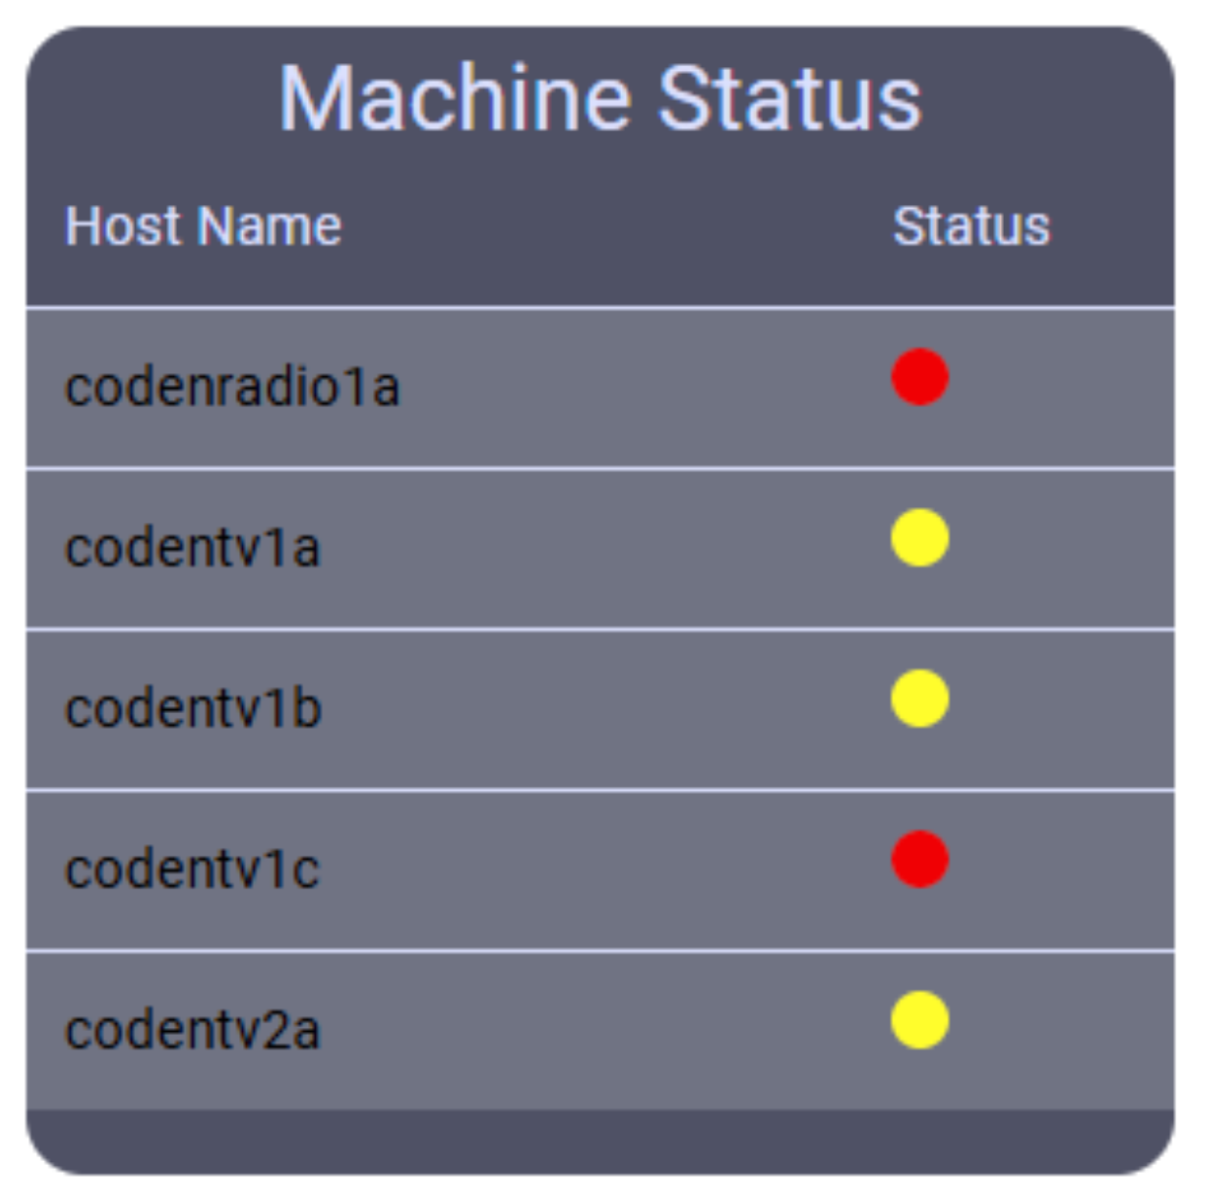
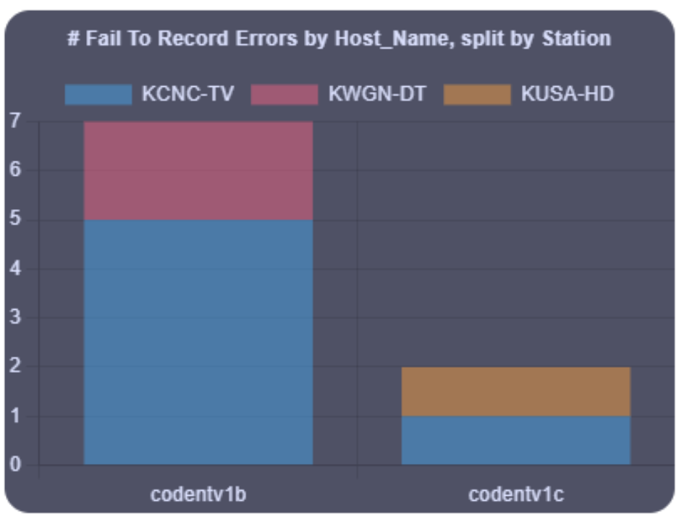
Key Aesthetic Requirements
Pages are appealing
Boxes are well structured and labeled
All features displayed are functioning and accurate

Slide 15
Design Overview

Slide 16
DigiClips Overall Design

Slide 17
(Previous) Administrative Portal Design
Issues with previous design…
Outdated UI
Some features were duplicated
In the dashboard.
In their own pages.

Slide 18
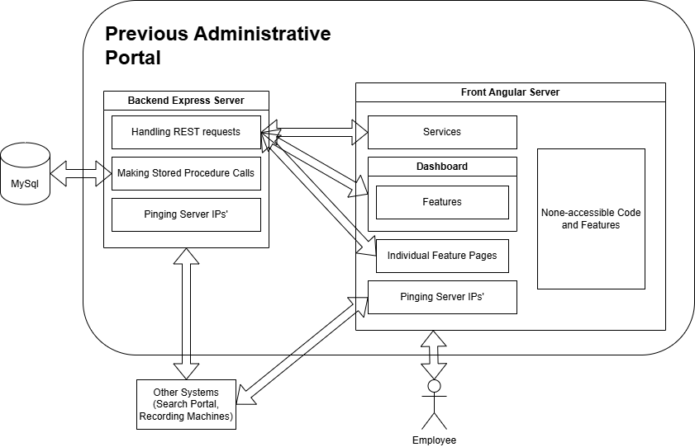
(Previous) Administrative Portal Design
Issues with previous design…
Pinging private servers is done by the client.
Angular Services only used to login.
Outdated database data
A large portion of unused features and code.

Slide 19
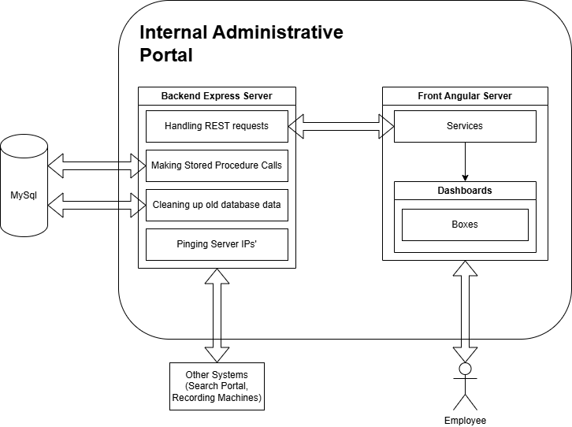
(Updated) Administrative Portal Design
Made up of two subsystems…
Backend Express Server
Front Angular Server
Which communicate by HTML Requests using the REST Api.
Simply overall code usage and data…
No duplicate feature code.
Refresh every 5 minutes

Slide 20
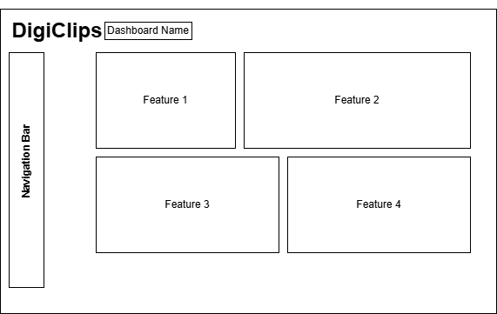
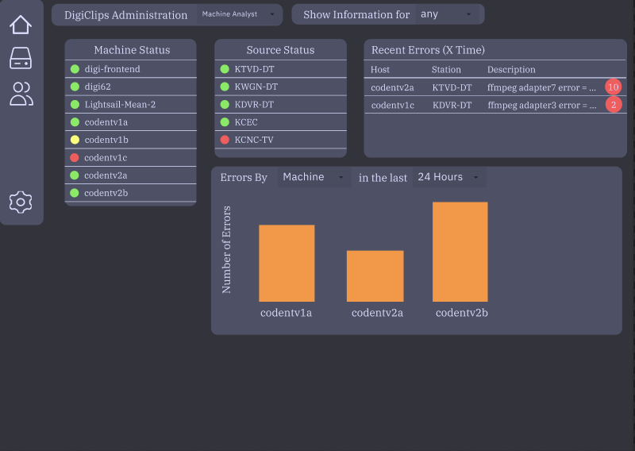
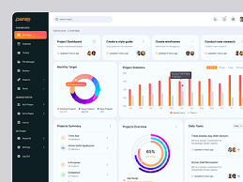
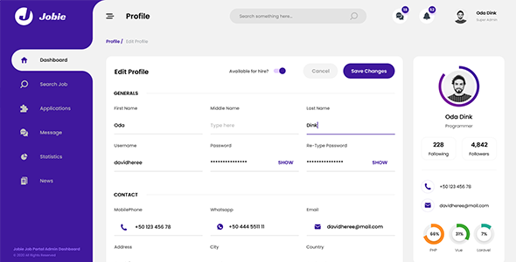
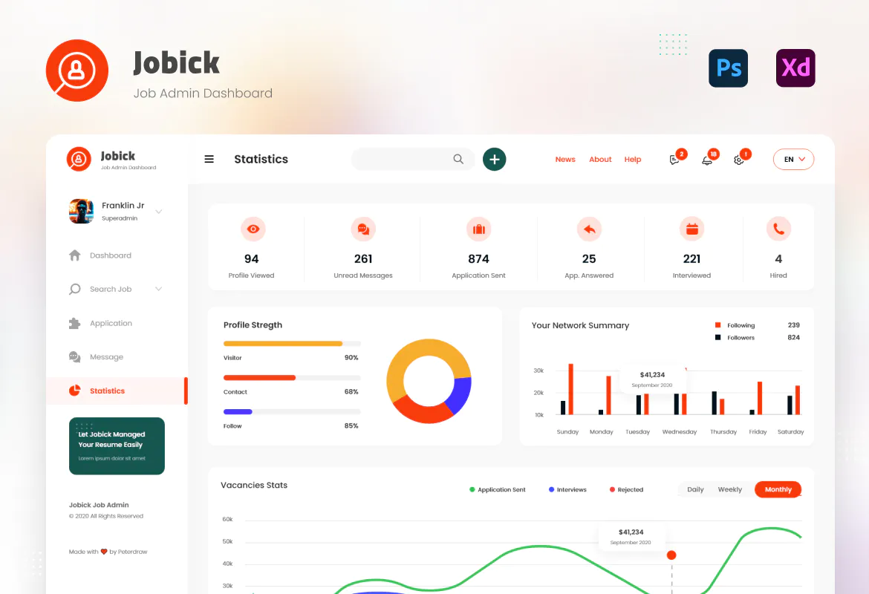
Market Research
to Design

Slide 21
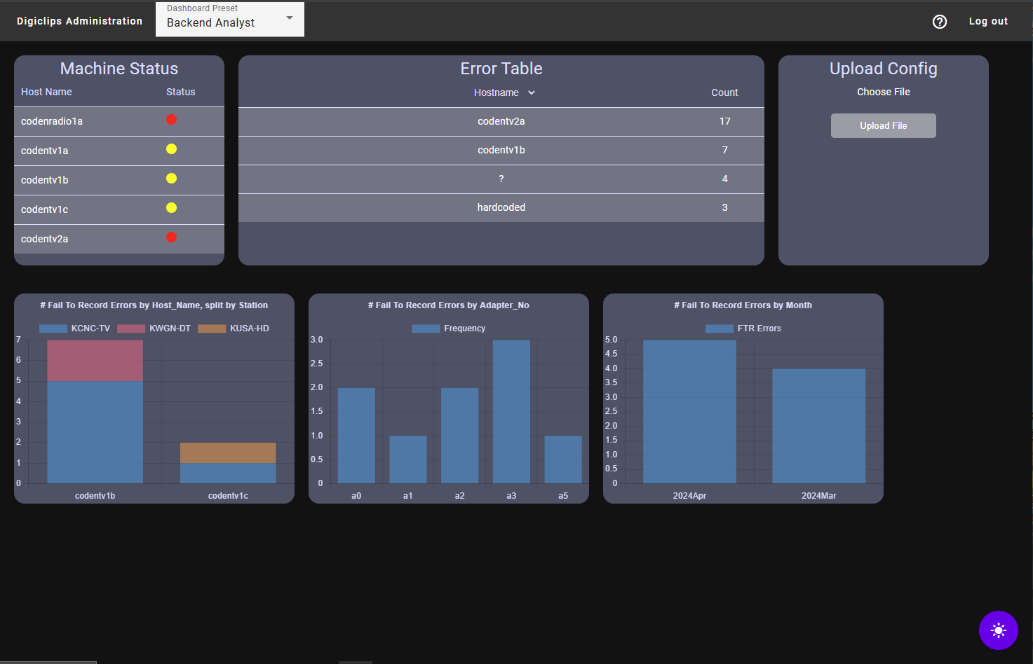
Visual Design
Goal is to break features into “boxes”...
Represents a single feature.
Reusable components.
Unified design.
These “boxes” are combined into dashboards…
Represents the functionality a user groups needs.

Slide 22
Results

Slide 23
Summary of Progress
Feature Conversion
100% of existing features
Cleaned Codebase
Only functioning code remains
Testing
Integration
Using production data
Acceptance
Client demos
Unit

Slide 24
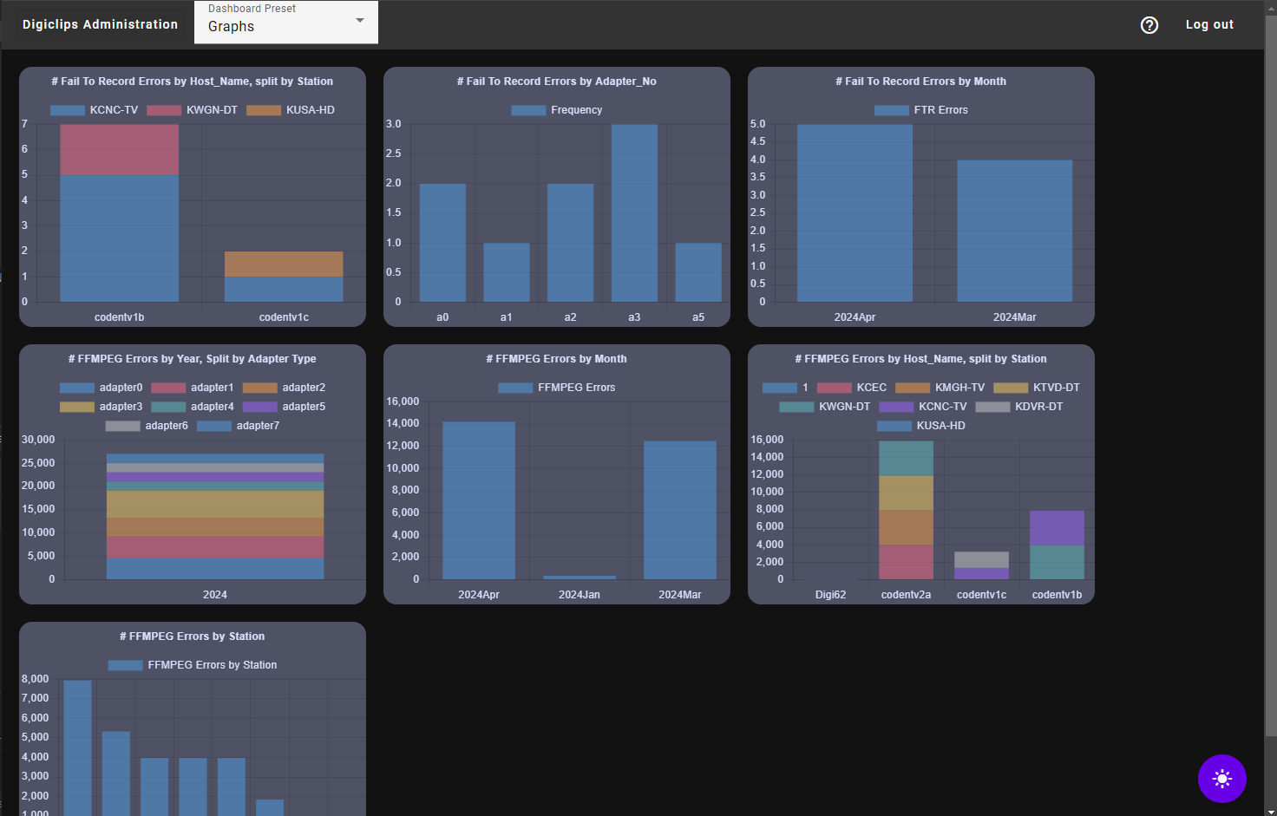
Value Provided
Cleaner UI
Only see what they need
Visually appealing
Reduced Tech Debt
Added consistency
Recorded documentation
Upgraded to Angular 18
Patched all vulnerable libraries

Slide 25
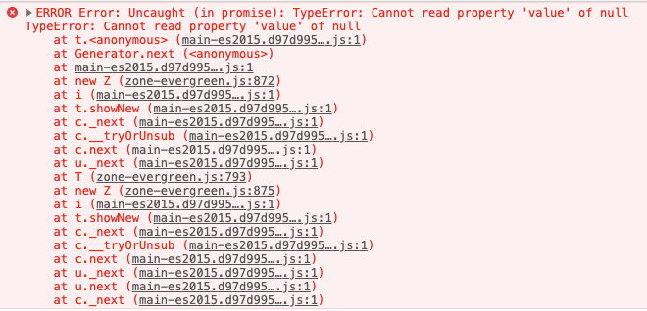
Problems Encountered and Solutions
Started with no Angular experience
Budgeted extra time during stories.
Gained a team member this semester
Replanned and reallocated users stories.
Technical difficulties gaining access to code base
Accessed through shared zip files.

Slide 26
Next Steps

Slide 27
Team Handoff
A team from Oregon State University will be continuing development…
Recorded videos.
Held transition meeting.

Slide 28
Recommended Features
Error Purging
Remove errors after X days
Modular Dashboards
Allow end-users to customize their dashboards
Persistent Accounts
Store hashed credentials in the database
Enable login from any instance
Website Configuration
Easily change the theme

Slide 29
Questions

